Slide 1

MakMak Timesheets
Week starting
dd
mm
yyyy
User name
Login

Slide 2
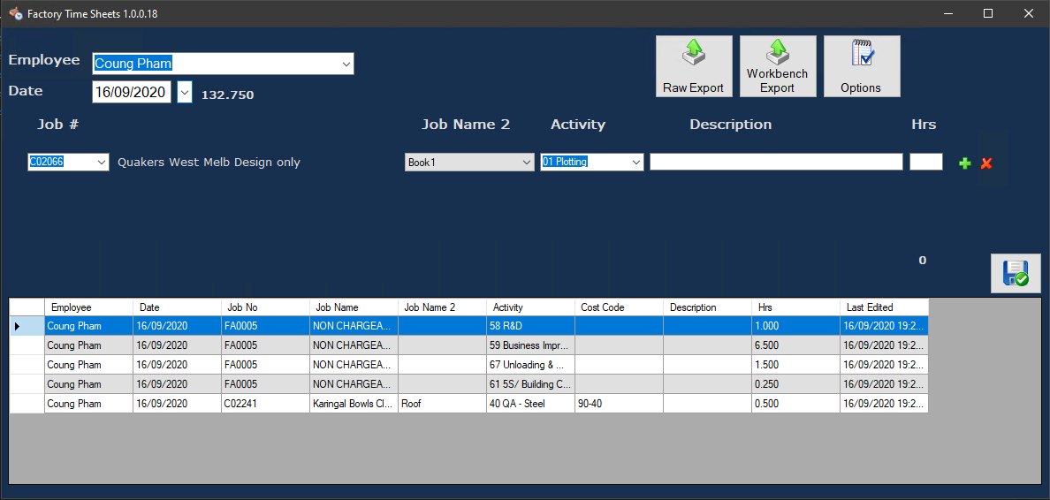

Slide 3
